Slide 1
Address Book (Robust)
Error Handling

Slide 2

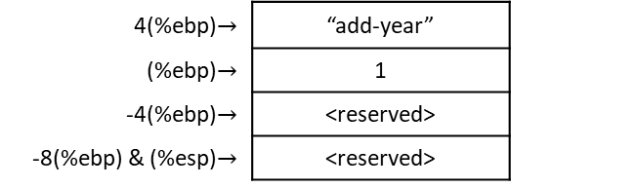
Robust add-year.s: open I/O files $→$ read input file $→$ age++ $→$ write output file
.section .text
.globl _start
_start:
movl %esp, %ebp # save stack pointer
subl $8, %esp # allocate space for local variables
# Open file for reading
movl $SYS_OPEN, %eax # prepare syscall 5
movl $input_file_name, %ebx # move input file name into %ebx
movl $0, %ecx # open in read-only mode
movl $0666, %edx
int $LINUX_SYSCALL # execute system call,
# sys_open returns file descriptor in %eax
movl %eax, ST_INPUT_DESCRIPTOR(%ebp) # store the input file
# descriptor away
# Open file for writing
movl $SYS_OPEN, %eax # prepare syscall 5
movl $output_file_name, %ebx # move output file name into %ebx
movl $0101, %ecx # open in write-only mode
movl $0666, %edx # and create if doesn’t exist
int $LINUX_SYSCALL # execute system call,
# sys_open returns file descriptor in %eax
movl %eax, ST_OUTPUT_DESCRIPTOR(%ebp) # store the output file
# descriptor away
4(%ebp)$→$ | “add-year”
(%ebp)$→$ | 1
-4(%ebp)$→$ | <reserved>
-8(%ebp) & (%esp)$→$ | <reserved>

Slide 3

Robust add-year.s: open I/O files $→$ read input file $→$ age++ $→$ write output file
.section .text
.globl _start
_start:
movl %esp, %ebp # save stack pointer
subl $8, %esp # allocate space for local variables
# Open file for reading
movl $SYS_OPEN, %eax # prepare syscall 5
movl $input_file_name, %ebx # move input file name into %ebx
movl $0, %ecx # open in read-only mode
movl $0666, %edx
int $LINUX_SYSCALL # execute system call,
# sys_open returns file descriptor in %eax
movl %eax, ST_INPUT_DESCRIPTOR(%ebp) # store the input file
# descriptor away
# This will test and see if %eax is negative.
# If it is not negative, it will jump to continue_processing.
# Otherwise it will handle the error condition that the negative number represents.
cmpl $0, %eax
jg continue_processing # in AT&T syntax, jg means eax > 0 ?
#Send the error
.section .data
no_open_file_code:
.ascii "0001: \0"
no_open_file_msg:
.ascii "Can’t Open Input File\0"
.section .text
pushl $no_open_file_msg
pushl $no_open_file_code
call error_exit
continue_processing:
# Open file for writing
movl $SYS_OPEN, %eax # prepare syscall 5
movl $output_file_name, %ebx # move output file name into %ebx
4(%ebp)$→$ | “add-year”
(%ebp)$→$ | 1
-4(%ebp)$→$ | <reserved>
-8(%ebp) & (%esp)$→$ | <reserved>

Slide 4

Robust add-year-robust.s: open I/O files $→$if input file exists
.section .text
.globl _start
_start:
movl %esp, %ebp # save stack pointer
subl $8, %esp # allocate space for local variables
# Open file for reading
movl $SYS_OPEN, %eax # prepare syscall 5
movl $input_file_name, %ebx # move input file name into %ebx
movl $0, %ecx # open in read-only mode
movl $0666, %edx
int $LINUX_SYSCALL # execute system call,
# sys_open returns file descriptor in %eax
movl %eax, ST_INPUT_DESCRIPTOR(%ebp) # store the input file
# descriptor away
# This will test and see if %eax is negative.
# If it is not negative, it will jump to continue_processing.
# Otherwise it will handle the error condition that the negative number represents.
cmpl $0, %eax
jg continue_processing # in AT&T syntax, jg means eax > 0 ?
#Send the error
.section .data
no_open_file_code:
.ascii "0001: \0"
no_open_file_msg:
.ascii "Can’t Open Input File\0"
.section .text
pushl $no_open_file_msg
pushl $no_open_file_code
call error_exit
continue_processing:
# Open file for writing
movl $SYS_OPEN, %eax # prepare syscall 5
movl $output_file_name, %ebx # move output file name into %ebx
if input file exists
test.dat
(input fd)
FrederickØ00000000000000000000000000000000BartlettØ000000000000000000000000000000004242 S Prairi
e\nTulsa, OK 55555Ø0000000000000
000000000000000000000000000000000000000000000000000000000000000000000000000000000000…

Slide 5
Robust add-year-robust.s: open I/O files $→$if input file exists
.section .text
.globl _start
_start:
movl %esp, %ebp # save stack pointer
subl $8, %esp # allocate space for local variables
# Open file for reading
movl $SYS_OPEN, %eax # prepare syscall 5
movl $input_file_name, %ebx # move input file name into %ebx
movl $0, %ecx # open in read-only mode
movl $0666, %edx
int $LINUX_SYSCALL # execute system call,
# sys_open returns file descriptor in %eax
movl %eax, ST_INPUT_DESCRIPTOR(%ebp) # store the input file
# descriptor away
# This will test and see if %eax is negative.
# If it is not negative, it will jump to continue_processing.
# Otherwise it will handle the error condition that the negative number represents.
cmpl $0, %eax
jg continue_processing # in AT&T syntax, jg means eax > 0 ?
#Send the error
.section .data
no_open_file_code:
.ascii "0001: \0"
no_open_file_msg:
.ascii "Can’t Open Input File\0"
.section .text
pushl $no_open_file_msg
pushl $no_open_file_code
call error_exit
continue_processing:
# Open file for writing
movl $SYS_OPEN, %eax # prepare syscall 5
movl $output_file_name, %ebx # move output file name into %ebx
4(%ebp)$→$ | “add-year”
(%ebp)$→$ | 1
-4(%ebp)$→$ | <reserved>
-8(%ebp) & (%esp)$→$ | <reserved>
test.dat
(input fd)
EAX = input fd (test.dat) = 3
EBX = “test.datØ”
ECX = 0
EDX = 0666
FrederickØ00000000000000000000000000000000BartlettØ000000000000000000000000000000004242 S Prairi
e\nTulsa, OK 55555Ø0000000000000
000000000000000000000000000000000000000000000000000000000000000000000000000000000000…

Slide 6
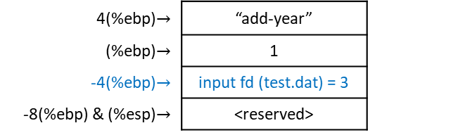
Robust add-year-robust.s: open I/O files $→$if input file exists
.section .text
.globl _start
_start:
movl %esp, %ebp # save stack pointer
subl $8, %esp # allocate space for local variables
# Open file for reading
movl $SYS_OPEN, %eax # prepare syscall 5
movl $input_file_name, %ebx # move input file name into %ebx
movl $0, %ecx # open in read-only mode
movl $0666, %edx
int $LINUX_SYSCALL # execute system call,
# sys_open returns file descriptor in %eax
movl %eax, ST_INPUT_DESCRIPTOR(%ebp) # store the input file
# descriptor away
# This will test and see if %eax is negative.
# If it is not negative, it will jump to continue_processing.
# Otherwise it will handle the error condition that the negative number represents.
cmpl $0, %eax
jg continue_processing # in AT&T syntax, jg means eax > 0 ?
#Send the error
.section .data
no_open_file_code:
.ascii "0001: \0"
no_open_file_msg:
.ascii "Can’t Open Input File\0"
.section .text
pushl $no_open_file_msg
pushl $no_open_file_code
call error_exit
continue_processing:
# Open file for writing
movl $SYS_OPEN, %eax # prepare syscall 5
movl $output_file_name, %ebx # move output file name into %ebx
4(%ebp)$→$ | “add-year”
(%ebp)$→$ | 1
-4(%ebp)$→$ | input fd (test.dat) = 3
-8(%ebp) & (%esp)$→$ | <reserved>
.equ ST_INPUT_DESCRIPTOR, -4
test.dat
(input fd)
EAX = input fd (test.dat) = 3
EBX = “test.datØ”
ECX = 0
EDX = 0666
FrederickØ00000000000000000000000000000000BartlettØ000000000000000000000000000000004242 S Prairi
e\nTulsa, OK 55555Ø0000000000000
000000000000000000000000000000000000000000000000000000000000000000000000000000000000…

Slide 7
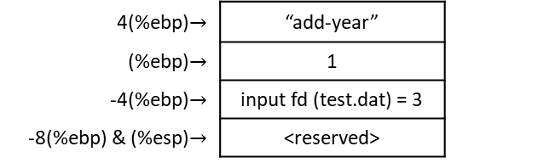
Robust add-year-robust.s: open I/O files $→$if input file exists
.section .text
.globl _start
_start:
movl %esp, %ebp # save stack pointer
subl $8, %esp # allocate space for local variables
# Open file for reading
movl $SYS_OPEN, %eax # prepare syscall 5
movl $input_file_name, %ebx # move input file name into %ebx
movl $0, %ecx # open in read-only mode
movl $0666, %edx
int $LINUX_SYSCALL # execute system call,
# sys_open returns file descriptor in %eax
movl %eax, ST_INPUT_DESCRIPTOR(%ebp) # store the input file
# descriptor away
# This will test and see if %eax is negative.
# If it is not negative, it will jump to continue_processing.
# Otherwise it will handle the error condition that the negative number represents.
cmpl $0, %eax
jg continue_processing # in AT&T syntax, jg means eax > 0 ?
#Send the error
.section .data
no_open_file_code:
.ascii "0001: \0"
no_open_file_msg:
.ascii "Can’t Open Input File\0"
.section .text
pushl $no_open_file_msg
pushl $no_open_file_code
call error_exit
continue_processing:
# Open file for writing
movl $SYS_OPEN, %eax # prepare syscall 5
movl $output_file_name, %ebx # move output file name into %ebx
4(%ebp)$→$ | “add-year”
(%ebp)$→$ | 1
-4(%ebp)$→$ | input fd (test.dat) = 3
-8(%ebp) & (%esp)$→$ | <reserved>
test.dat
(input fd)
EAX = input fd (test.dat) = 3
EBX = “test.datØ”
ECX = 0
EDX = 0666
FrederickØ00000000000000000000000000000000BartlettØ000000000000000000000000000000004242 S Prairi
e\nTulsa, OK 55555Ø0000000000000
000000000000000000000000000000000000000000000000000000000000000000000000000000000000…

Slide 8
Robust add-year-robust.s: open I/O files $→$if input file exists
.section .text
.globl _start
_start:
movl %esp, %ebp # save stack pointer
subl $8, %esp # allocate space for local variables
# Open file for reading
movl $SYS_OPEN, %eax # prepare syscall 5
movl $input_file_name, %ebx # move input file name into %ebx
movl $0, %ecx # open in read-only mode
movl $0666, %edx
int $LINUX_SYSCALL # execute system call,
# sys_open returns file descriptor in %eax
movl %eax, ST_INPUT_DESCRIPTOR(%ebp) # store the input file
# descriptor away
# This will test and see if %eax is negative.
# If it is not negative, it will jump to continue_processing.
# Otherwise it will handle the error condition that the negative number represents.
cmpl $0, %eax
jg continue_processing # in AT&T syntax, jg means eax > 0 ?
#Send the error
.section .data
no_open_file_code:
.ascii "0001: \0"
no_open_file_msg:
.ascii "Can’t Open Input File\0"
.section .text
pushl $no_open_file_msg
pushl $no_open_file_code
call error_exit
continue_processing:
# Open file for writing
movl $SYS_OPEN, %eax # prepare syscall 5
movl $output_file_name, %ebx # move output file name into %ebx
4(%ebp)$→$ | “add-year”
(%ebp)$→$ | 1
-4(%ebp)$→$ | input fd (test.dat) = 3
-8(%ebp) & (%esp)$→$ | <reserved>
test.dat
(input fd)
EAX = input fd (test.dat) = 3
EBX = “test.datØ”
ECX = 0
EDX = 0666
FrederickØ00000000000000000000000000000000BartlettØ000000000000000000000000000000004242 S Prairi
e\nTulsa, OK 55555Ø0000000000000
000000000000000000000000000000000000000000000000000000000000000000000000000000000000…

Slide 9
Robust add-year-robust.s: open I/O files $→$if input file exists
.section .text
.globl _start
_start:
movl %esp, %ebp # save stack pointer
subl $8, %esp # allocate space for local variables
# Open file for reading
movl $SYS_OPEN, %eax # prepare syscall 5
movl $input_file_name, %ebx # move input file name into %ebx
movl $0, %ecx # open in read-only mode
movl $0666, %edx
int $LINUX_SYSCALL # execute system call,
# sys_open returns file descriptor in %eax
movl %eax, ST_INPUT_DESCRIPTOR(%ebp) # store the input file
# descriptor away
# This will test and see if %eax is negative.
# If it is not negative, it will jump to continue_processing.
# Otherwise it will handle the error condition that the negative number represents.
cmpl $0, %eax
jg continue_processing # in AT&T syntax, jg means eax > 0 ?
#Send the error
.section .data
no_open_file_code:
.ascii "0001: \0"
no_open_file_msg:
.ascii "Can’t Open Input File\0"
.section .text
pushl $no_open_file_msg
pushl $no_open_file_code
call error_exit
continue_processing:
# Open file for writing
movl $SYS_OPEN, %eax # prepare syscall 5
movl $output_file_name, %ebx # move output file name into %ebx
4(%ebp)$→$ | “add-year”
(%ebp)$→$ | 1
-4(%ebp)$→$ | input fd (test.dat) = 3
-8(%ebp) & (%esp)$→$ | <reserved>
test.dat
(input fd)
EAX = input fd (test.dat) = 3
EBX = “test.datØ”
ECX = 0
EDX = 0666
FrederickØ00000000000000000000000000000000BartlettØ000000000000000000000000000000004242 S Prairi
e\nTulsa, OK 55555Ø0000000000000
000000000000000000000000000000000000000000000000000000000000000000000000000000000000…

Slide 10
Robust add-year-robust.s: open I/O files $→$if input file exists
.section .text
.globl _start
_start:
movl %esp, %ebp # save stack pointer
subl $8, %esp # allocate space for local variables
# Open file for reading
movl $SYS_OPEN, %eax # prepare syscall 5
movl $input_file_name, %ebx # move input file name into %ebx
movl $0, %ecx # open in read-only mode
movl $0666, %edx
int $LINUX_SYSCALL # execute system call,
# sys_open returns file descriptor in %eax
movl %eax, ST_INPUT_DESCRIPTOR(%ebp) # store the input file
# descriptor away
# This will test and see if %eax is negative.
# If it is not negative, it will jump to continue_processing.
# Otherwise it will handle the error condition that the negative number represents.
cmpl $0, %eax
jg continue_processing # in AT&T syntax, jg means eax > 0 ?
#Send the error
.section .data
no_open_file_code:
.ascii "0001: \0"
no_open_file_msg:
.ascii "Can’t Open Input File\0"
.section .text
pushl $no_open_file_msg
pushl $no_open_file_code
call error_exit
continue_processing:
# Open file for writing
movl $SYS_OPEN, %eax # prepare syscall 5
movl $output_file_name, %ebx # move output file name into %ebx
4(%ebp)$→$ | “add-year”
(%ebp)$→$ | 1
-4(%ebp)$→$ | input fd (test.dat) = 3
-8(%ebp) & (%esp)$→$ | <reserved>
test.dat
(input fd)
EAX = input fd (test.dat) = 3
EBX = “test.datØ”
ECX = 0
EDX = 0666
FrederickØ00000000000000000000000000000000BartlettØ000000000000000000000000000000004242 S Prairi
e\nTulsa, OK 55555Ø0000000000000
000000000000000000000000000000000000000000000000000000000000000000000000000000000000…

Slide 11

Robust add-year-robust.s: open I/O files $→$if input file exists
.section .text
.globl _start
_start:
movl %esp, %ebp # save stack pointer
subl $8, %esp # allocate space for local variables
# Open file for reading
movl $SYS_OPEN, %eax # prepare syscall 5
movl $input_file_name, %ebx # move input file name into %ebx
movl $0, %ecx # open in read-only mode
movl $0666, %edx
int $LINUX_SYSCALL # execute system call,
# sys_open returns file descriptor in %eax
movl %eax, ST_INPUT_DESCRIPTOR(%ebp) # store the input file
# descriptor away
# This will test and see if %eax is negative.
# If it is not negative, it will jump to continue_processing.
# Otherwise it will handle the error condition that the negative number represents.
cmpl $0, %eax
jg continue_processing # in AT&T syntax, jg means eax > 0 ?
#Send the error
.section .data
no_open_file_code:
.ascii "0001: \0"
no_open_file_msg:
.ascii "Can’t Open Input File\0"
.section .text
pushl $no_open_file_msg
pushl $no_open_file_code
call error_exit
continue_processing:
# Open file for writing
movl $SYS_OPEN, %eax # prepare syscall 5
movl $output_file_name, %ebx # move output file name into %ebx
4(%ebp)$→$ | “add-year”
(%ebp)$→$ | 1
-4(%ebp)$→$ | input fd (test.dat) = 3
-8(%ebp) & (%esp)$→$ | <reserved>
3 > 0 ? $→$ true
test.dat
(input fd)
EAX = input fd (test.dat) = 3
EBX = “test.datØ”
ECX = 0
EDX = 0666
FrederickØ00000000000000000000000000000000BartlettØ000000000000000000000000000000004242 S Prairi
e\nTulsa, OK 55555Ø0000000000000
000000000000000000000000000000000000000000000000000000000000000000000000000000000000…

Slide 12
Robust add-year-robust.s: open I/O files $→$if input file exists
.section .text
.globl _start
_start:
movl %esp, %ebp # save stack pointer
subl $8, %esp # allocate space for local variables
# Open file for reading
movl $SYS_OPEN, %eax # prepare syscall 5
movl $input_file_name, %ebx # move input file name into %ebx
movl $0, %ecx # open in read-only mode
movl $0666, %edx
int $LINUX_SYSCALL # execute system call,
# sys_open returns file descriptor in %eax
movl %eax, ST_INPUT_DESCRIPTOR(%ebp) # store the input file
# descriptor away
# This will test and see if %eax is negative.
# If it is not negative, it will jump to continue_processing.
# Otherwise it will handle the error condition that the negative number represents.
cmpl $0, %eax
jg continue_processing # in AT&T syntax, jg means eax > 0 ?
#Send the error
.section .data
no_open_file_code:
.ascii "0001: \0"
no_open_file_msg:
.ascii "Can’t Open Input File\0"
.section .text
pushl $no_open_file_msg
pushl $no_open_file_code
call error_exit
continue_processing:
# Open file for writing
movl $SYS_OPEN, %eax # prepare syscall 5
movl $output_file_name, %ebx # move output file name into %ebx
4(%ebp)$→$ | “add-year”
(%ebp)$→$ | 1
-4(%ebp)$→$ | input fd (test.dat) = 3
-8(%ebp) & (%esp)$→$ | <reserved>
test.dat
(input fd)
EAX = input fd (test.dat) = 3
EBX = “test.datØ”
ECX = 0
EDX = 0666
FrederickØ00000000000000000000000000000000BartlettØ000000000000000000000000000000004242 S Prairi
e\nTulsa, OK 55555Ø0000000000000
000000000000000000000000000000000000000000000000000000000000000000000000000000000000…

Slide 13
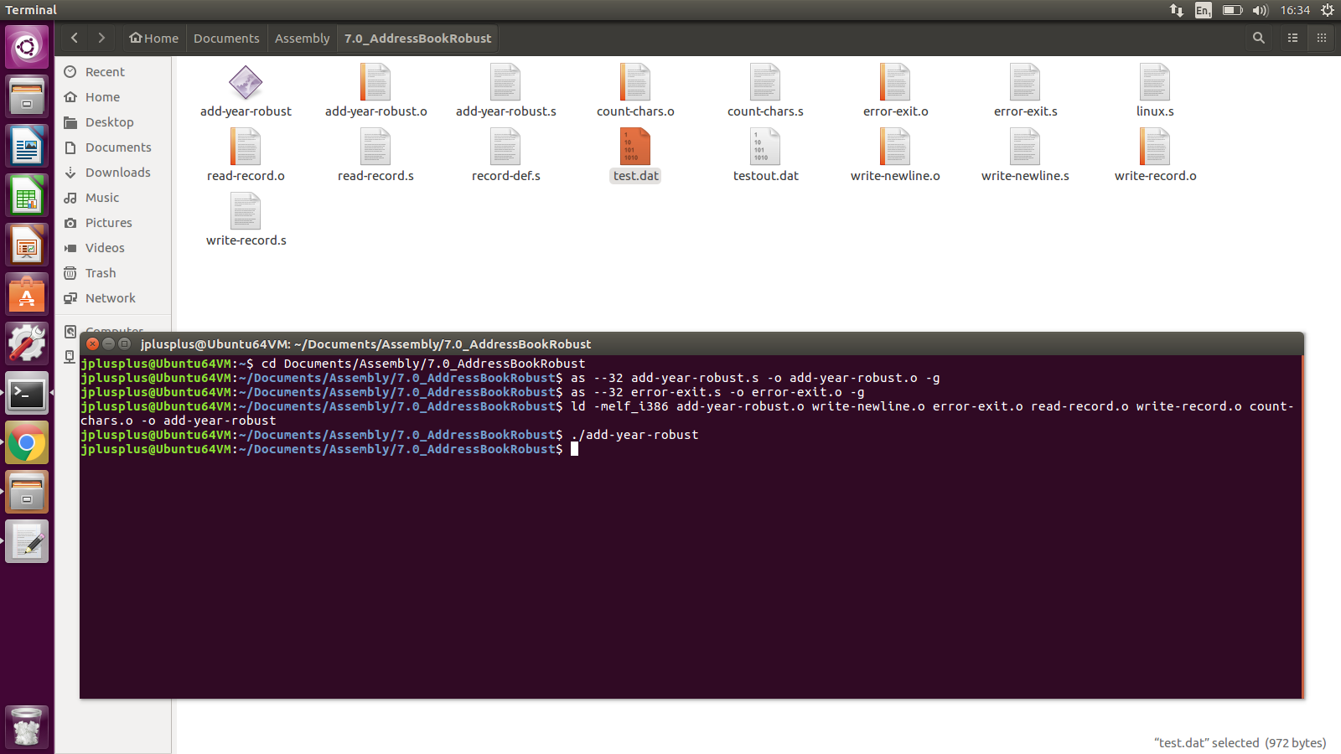
Robust Answer: if input file exists
EAX = input fd (test.dat) = 3
EBX = “test.datØ”
ECX = 0
EDX = 0666

Slide 14

Robust add-year-robust.s: open I/O files $→$if input file does not exist
.section .text
.globl _start
_start:
movl %esp, %ebp # save stack pointer
subl $8, %esp # allocate space for local variables
# Open file for reading
movl $SYS_OPEN, %eax # prepare syscall 5
movl $input_file_name, %ebx # move input file name into %ebx
movl $0, %ecx # open in read-only mode
movl $0666, %edx
int $LINUX_SYSCALL # execute system call,
# sys_open returns file descriptor in %eax
movl %eax, ST_INPUT_DESCRIPTOR(%ebp) # store the input file
# descriptor away
# This will test and see if %eax is negative.
# If it is not negative, it will jump to continue_processing.
# Otherwise it will handle the error condition that the negative number represents.
cmpl $0, %eax
jg continue_processing # in AT&T syntax, jg means eax > 0 ?
#Send the error
.section .data
no_open_file_code:
.ascii "0001: \0"
no_open_file_msg:
.ascii "Can’t Open Input File\0"
.section .text
pushl $no_open_file_msg
pushl $no_open_file_code
call error_exit
continue_processing:
# Open file for writing
movl $SYS_OPEN, %eax # prepare syscall 5
movl $output_file_name, %ebx # move output file name into %ebx
if input file does not exist
test.dat
(input fd)
FrederickØ00000000000000000000000000000000BartlettØ000000000000000000000000000000004242 S Prairi
e\nTulsa, OK 55555Ø0000000000000
000000000000000000000000000000000000000000000000000000000000000000000000000000000000…

Slide 15
Robust add-year-robust.s: open I/O files $→$if input file does not exist
.section .text
.globl _start
_start:
movl %esp, %ebp # save stack pointer
subl $8, %esp # allocate space for local variables
# Open file for reading
movl $SYS_OPEN, %eax # prepare syscall 5
movl $input_file_name, %ebx # move input file name into %ebx
movl $0, %ecx # open in read-only mode
movl $0666, %edx
int $LINUX_SYSCALL # execute system call,
# sys_open returns file descriptor in %eax
movl %eax, ST_INPUT_DESCRIPTOR(%ebp) # store the input file
# descriptor away
# This will test and see if %eax is negative.
# If it is not negative, it will jump to continue_processing.
# Otherwise it will handle the error condition that the negative number represents.
cmpl $0, %eax
jg continue_processing # in AT&T syntax, jg means eax > 0 ?
#Send the error
.section .data
no_open_file_code:
.ascii "0001: \0"
no_open_file_msg:
.ascii "Can’t Open Input File\0"
.section .text
pushl $no_open_file_msg
pushl $no_open_file_code
call error_exit
continue_processing:
# Open file for writing
movl $SYS_OPEN, %eax # prepare syscall 5
movl $output_file_name, %ebx # move output file name into %ebx
4(%ebp)$→$ | “add-year”
(%ebp)$→$ | 1
-4(%ebp)$→$ | <reserved>
-8(%ebp) & (%esp)$→$ | <reserved>
test.dat
(input fd)
EAX = input fd (test.dat) = neg
EBX = “test.datØ”
ECX = 0
EDX = 0666
FrederickØ00000000000000000000000000000000BartlettØ000000000000000000000000000000004242 S Prairi
e\nTulsa, OK 55555Ø0000000000000
000000000000000000000000000000000000000000000000000000000000000000000000000000000000…

Slide 16
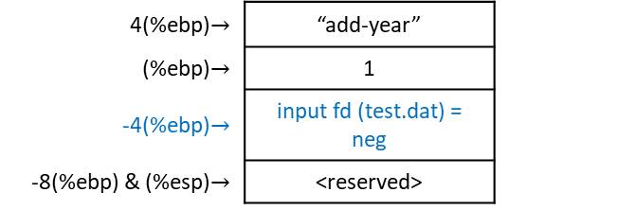
Robust add-year-robust.s: open I/O files $→$if input file does not exist
.section .text
.globl _start
_start:
movl %esp, %ebp # save stack pointer
subl $8, %esp # allocate space for local variables
# Open file for reading
movl $SYS_OPEN, %eax # prepare syscall 5
movl $input_file_name, %ebx # move input file name into %ebx
movl $0, %ecx # open in read-only mode
movl $0666, %edx
int $LINUX_SYSCALL # execute system call,
# sys_open returns file descriptor in %eax
movl %eax, ST_INPUT_DESCRIPTOR(%ebp) # store the input file
# descriptor away
# This will test and see if %eax is negative.
# If it is not negative, it will jump to continue_processing.
# Otherwise it will handle the error condition that the negative number represents.
cmpl $0, %eax
jg continue_processing # in AT&T syntax, jg means eax > 0 ?
#Send the error
.section .data
no_open_file_code:
.ascii "0001: \0"
no_open_file_msg:
.ascii "Can’t Open Input File\0"
.section .text
pushl $no_open_file_msg
pushl $no_open_file_code
call error_exit
continue_processing:
# Open file for writing
movl $SYS_OPEN, %eax # prepare syscall 5
movl $output_file_name, %ebx # move output file name into %ebx
4(%ebp)$→$ | “add-year”
(%ebp)$→$ | 1
-4(%ebp)$→$ | input fd (test.dat) = neg
-8(%ebp) & (%esp)$→$ | <reserved>
.equ ST_INPUT_DESCRIPTOR, -4
test.dat
(input fd)
EAX = input fd (test.dat) = neg
EBX = “test.datØ”
ECX = 0
EDX = 0666
FrederickØ00000000000000000000000000000000BartlettØ000000000000000000000000000000004242 S Prairi
e\nTulsa, OK 55555Ø0000000000000
000000000000000000000000000000000000000000000000000000000000000000000000000000000000…

Slide 17
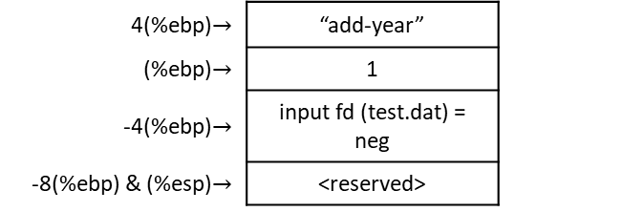

Robust add-year-robust.s: open I/O files $→$if input file does not exist
.section .text
.globl _start
_start:
movl %esp, %ebp # save stack pointer
subl $8, %esp # allocate space for local variables
# Open file for reading
movl $SYS_OPEN, %eax # prepare syscall 5
movl $input_file_name, %ebx # move input file name into %ebx
movl $0, %ecx # open in read-only mode
movl $0666, %edx
int $LINUX_SYSCALL # execute system call,
# sys_open returns file descriptor in %eax
movl %eax, ST_INPUT_DESCRIPTOR(%ebp) # store the input file
# descriptor away
# This will test and see if %eax is negative.
# If it is not negative, it will jump to continue_processing.
# Otherwise it will handle the error condition that the negative number represents.
cmpl $0, %eax
jg continue_processing # in AT&T syntax, jg means eax > 0 ?
#Send the error
.section .data
no_open_file_code:
.ascii "0001: \0"
no_open_file_msg:
.ascii "Can’t Open Input File\0"
.section .text
pushl $no_open_file_msg
pushl $no_open_file_code
call error_exit
continue_processing:
# Open file for writing
movl $SYS_OPEN, %eax # prepare syscall 5
movl $output_file_name, %ebx # move output file name into %ebx
4(%ebp)$→$ | “add-year”
(%ebp)$→$ | 1
-4(%ebp)$→$ | input fd (test.dat) = neg
-8(%ebp) & (%esp)$→$ | <reserved>
neg > 0 ? $→$ false
test.dat
(input fd)
EAX = input fd (test.dat) = neg
EBX = “test.datØ”
ECX = 0
EDX = 0666
FrederickØ00000000000000000000000000000000BartlettØ000000000000000000000000000000004242 S Prairi
e\nTulsa, OK 55555Ø0000000000000
000000000000000000000000000000000000000000000000000000000000000000000000000000000000…

Slide 18
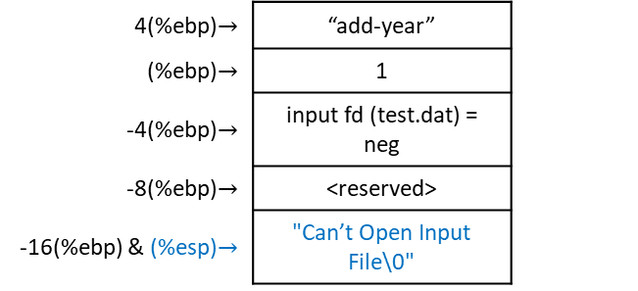
Robust add-year-robust.s: open I/O files $→$if input file does not exist
.section .text
.globl _start
_start:
movl %esp, %ebp # save stack pointer
subl $8, %esp # allocate space for local variables
# Open file for reading
movl $SYS_OPEN, %eax # prepare syscall 5
movl $input_file_name, %ebx # move input file name into %ebx
movl $0, %ecx # open in read-only mode
movl $0666, %edx
int $LINUX_SYSCALL # execute system call,
# sys_open returns file descriptor in %eax
movl %eax, ST_INPUT_DESCRIPTOR(%ebp) # store the input file
# descriptor away
# This will test and see if %eax is negative.
# If it is not negative, it will jump to continue_processing.
# Otherwise it will handle the error condition that the negative number represents.
cmpl $0, %eax
jg continue_processing # in AT&T syntax, jg means eax > 0 ?
#Send the error
.section .data
no_open_file_code:
.ascii "0001: \0"
no_open_file_msg:
.ascii "Can’t Open Input File\0"
.section .text
pushl $no_open_file_msg
pushl $no_open_file_code
call error_exit
continue_processing:
# Open file for writing
movl $SYS_OPEN, %eax # prepare syscall 5
movl $output_file_name, %ebx # move output file name into %ebx
4(%ebp)$→$ | “add-year”
(%ebp)$→$ | 1
-4(%ebp)$→$ | input fd (test.dat) = neg
-8(%ebp)$→$ | <reserved>
-16(%ebp) & (%esp)$→$ | "Can’t Open Input File\0"
test.dat
(input fd)
EAX = input fd (test.dat) = neg
EBX = “test.datØ”
ECX = 0
EDX = 0666
FrederickØ00000000000000000000000000000000BartlettØ000000000000000000000000000000004242 S Prairi
e\nTulsa, OK 55555Ø0000000000000
000000000000000000000000000000000000000000000000000000000000000000000000000000000000…

Slide 19
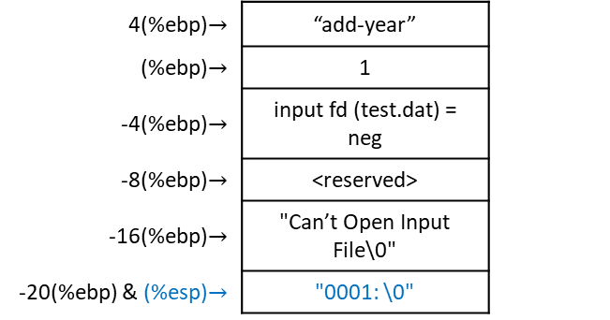
Robust add-year-robust.s: open I/O files $→$if input file does not exist
.section .text
.globl _start
_start:
movl %esp, %ebp # save stack pointer
subl $8, %esp # allocate space for local variables
# Open file for reading
movl $SYS_OPEN, %eax # prepare syscall 5
movl $input_file_name, %ebx # move input file name into %ebx
movl $0, %ecx # open in read-only mode
movl $0666, %edx
int $LINUX_SYSCALL # execute system call,
# sys_open returns file descriptor in %eax
movl %eax, ST_INPUT_DESCRIPTOR(%ebp) # store the input file
# descriptor away
# This will test and see if %eax is negative.
# If it is not negative, it will jump to continue_processing.
# Otherwise it will handle the error condition that the negative number represents.
cmpl $0, %eax
jg continue_processing # in AT&T syntax, jg means eax > 0 ?
#Send the error
.section .data
no_open_file_code:
.ascii "0001: \0"
no_open_file_msg:
.ascii "Can’t Open Input File\0"
.section .text
pushl $no_open_file_msg
pushl $no_open_file_code
call error_exit
continue_processing:
# Open file for writing
movl $SYS_OPEN, %eax # prepare syscall 5
movl $output_file_name, %ebx # move output file name into %ebx
4(%ebp)$→$ | “add-year”
(%ebp)$→$ | 1
-4(%ebp)$→$ | input fd (test.dat) = neg
-8(%ebp)$→$ | <reserved>
-16(%ebp)$→$ | "Can’t Open Input File\0"
-20(%ebp) & (%esp)$→$ | "0001: \0"
test.dat
(input fd)
EAX = input fd (test.dat) = neg
EBX = “test.datØ”
ECX = 0
EDX = 0666
FrederickØ00000000000000000000000000000000BartlettØ000000000000000000000000000000004242 S Prairi
e\nTulsa, OK 55555Ø0000000000000
000000000000000000000000000000000000000000000000000000000000000000000000000000000000…

Slide 20
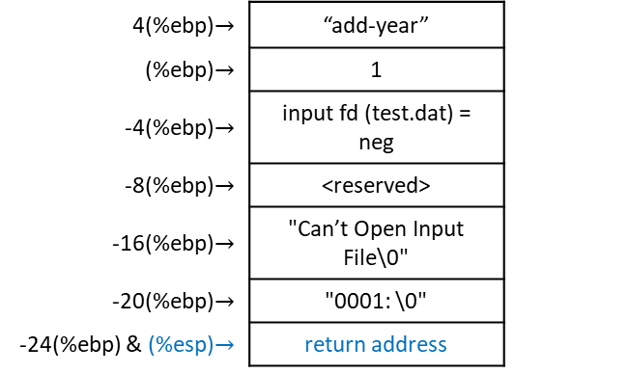
Robust add-year-robust.s: open I/O files $→$if input file does not exist
.section .text
.globl _start
_start:
movl %esp, %ebp # save stack pointer
subl $8, %esp # allocate space for local variables
# Open file for reading
movl $SYS_OPEN, %eax # prepare syscall 5
movl $input_file_name, %ebx # move input file name into %ebx
movl $0, %ecx # open in read-only mode
movl $0666, %edx
int $LINUX_SYSCALL # execute system call,
# sys_open returns file descriptor in %eax
movl %eax, ST_INPUT_DESCRIPTOR(%ebp) # store the input file
# descriptor away
# This will test and see if %eax is negative.
# If it is not negative, it will jump to continue_processing.
# Otherwise it will handle the error condition that the negative number represents.
cmpl $0, %eax
jg continue_processing # in AT&T syntax, jg means eax > 0 ?
#Send the error
.section .data
no_open_file_code:
.ascii "0001: \0"
no_open_file_msg:
.ascii "Can’t Open Input File\0"
.section .text
pushl $no_open_file_msg
pushl $no_open_file_code
call error_exit
continue_processing:
# Open file for writing
movl $SYS_OPEN, %eax # prepare syscall 5
movl $output_file_name, %ebx # move output file name into %ebx
4(%ebp)$→$ | “add-year”
(%ebp)$→$ | 1
-4(%ebp)$→$ | input fd (test.dat) = neg
-8(%ebp)$→$ | <reserved>
-16(%ebp)$→$ | "Can’t Open Input File\0"
-20(%ebp)$→$ | "0001: \0"
-24(%ebp) & (%esp)$→$ | return address
test.dat
(input fd)
EAX = input fd (test.dat) = neg
EBX = “test.datØ”
ECX = 0
EDX = 0666
FrederickØ00000000000000000000000000000000BartlettØ000000000000000000000000000000004242 S Prairi
e\nTulsa, OK 55555Ø0000000000000
000000000000000000000000000000000000000000000000000000000000000000000000000000000000…

Slide 21

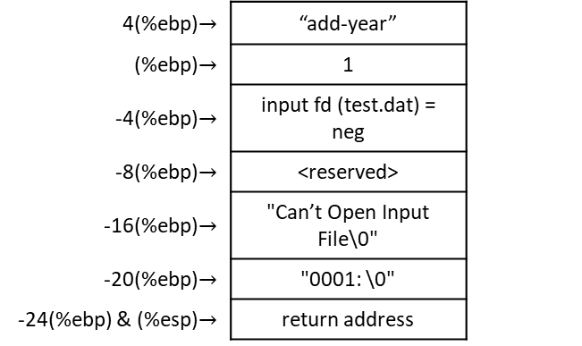
Robust add-year-robust.s: open I/O files $→$if input file does not exist $→$error-exit.s
.include "linux.s"
.equ ST_ERROR_CODE, 8
.equ ST_ERROR_MSG, 12
.globl error_exit
.type error_exit, @function
error_exit:
pushl %ebp
movl %esp, %ebp
# Write out error code
movl ST_ERROR_CODE(%ebp), %ecx
pushl %ecx
call count_chars
popl %ecx
movl %eax, %edx
movl $STDERR, %ebx
movl $SYS_WRITE, %eax
int $LINUX_SYSCALL
# Write out error message
movl ST_ERROR_MSG(%ebp), %ecx
pushl %ecx
call count_chars
popl %ecx
movl %eax, %edx
movl $STDERR, %ebx
movl $SYS_WRITE, %eax
int $LINUX_SYSCALL
pushl $STDERR
call write_newline
# Exit with status 1
movl $SYS_EXIT, %eax
movl $1, %ebx
int $LINUX_SYSCALL
4(%ebp)$→$ | “add-year”
(%ebp)$→$ | 1
-4(%ebp)$→$ | input fd (test.dat) = neg
-8(%ebp)$→$ | <reserved>
-16(%ebp)$→$ | "Can’t Open Input File\0"
-20(%ebp)$→$ | "0001: \0"
-24(%ebp) & (%esp)$→$ | return address
test.dat
(input fd)
EAX = input fd (test.dat) = neg
EBX = “test.datØ”
ECX = 0
EDX = 0666
FrederickØ00000000000000000000000000000000BartlettØ000000000000000000000000000000004242 S Prairi
e\nTulsa, OK 55555Ø0000000000000
000000000000000000000000000000000000000000000000000000000000000000000000000000000000…

Slide 22
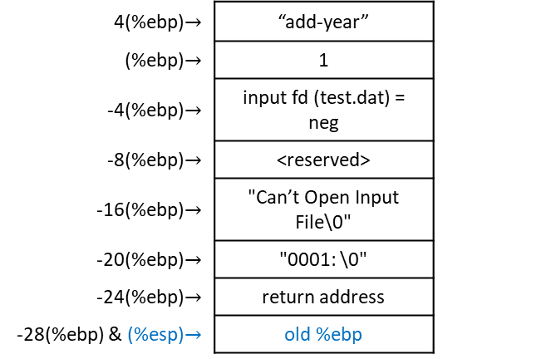
Robust add-year-robust.s: open I/O files $→$if input file does not exist $→$error-exit.s
.include "linux.s"
.equ ST_ERROR_CODE, 8
.equ ST_ERROR_MSG, 12
.globl error_exit
.type error_exit, @function
error_exit:
pushl %ebp
movl %esp, %ebp
# Write out error code
movl ST_ERROR_CODE(%ebp), %ecx
pushl %ecx
call count_chars
popl %ecx
movl %eax, %edx
movl $STDERR, %ebx
movl $SYS_WRITE, %eax
int $LINUX_SYSCALL
# Write out error message
movl ST_ERROR_MSG(%ebp), %ecx
pushl %ecx
call count_chars
popl %ecx
movl %eax, %edx
movl $STDERR, %ebx
movl $SYS_WRITE, %eax
int $LINUX_SYSCALL
pushl $STDERR
call write_newline
# Exit with status 1
movl $SYS_EXIT, %eax
movl $1, %ebx
int $LINUX_SYSCALL
4(%ebp)$→$ | “add-year”
(%ebp)$→$ | 1
-4(%ebp)$→$ | input fd (test.dat) = neg
-8(%ebp)$→$ | <reserved>
-16(%ebp)$→$ | "Can’t Open Input File\0"
-20(%ebp)$→$ | "0001: \0"
-24(%ebp)$→$ | return address
-28(%ebp) & (%esp)$→$ | old %ebp
test.dat
(input fd)
EAX = input fd (test.dat) = neg
EBX = “test.datØ”
ECX = 0
EDX = 0666
FrederickØ00000000000000000000000000000000BartlettØ000000000000000000000000000000004242 S Prairi
e\nTulsa, OK 55555Ø0000000000000
000000000000000000000000000000000000000000000000000000000000000000000000000000000000…

Slide 23
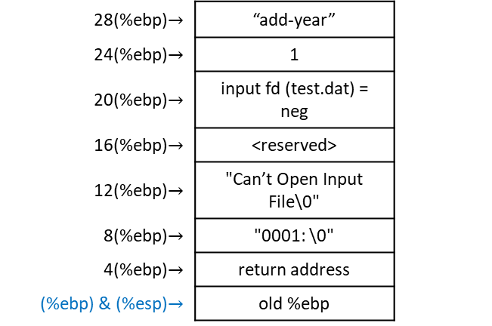

Robust add-year-robust.s: open I/O files $→$if input file does not exist $→$error-exit.s
.include "linux.s"
.equ ST_ERROR_CODE, 8
.equ ST_ERROR_MSG, 12
.globl error_exit
.type error_exit, @function
error_exit:
pushl %ebp
movl %esp, %ebp
# Write out error code
movl ST_ERROR_CODE(%ebp), %ecx
pushl %ecx
call count_chars
popl %ecx
movl %eax, %edx
movl $STDERR, %ebx
movl $SYS_WRITE, %eax
int $LINUX_SYSCALL
# Write out error message
movl ST_ERROR_MSG(%ebp), %ecx
pushl %ecx
call count_chars
popl %ecx
movl %eax, %edx
movl $STDERR, %ebx
movl $SYS_WRITE, %eax
int $LINUX_SYSCALL
pushl $STDERR
call write_newline
# Exit with status 1
movl $SYS_EXIT, %eax
movl $1, %ebx
int $LINUX_SYSCALL
28(%ebp)$→$ | “add-year”
24(%ebp)$→$ | 1
20(%ebp)$→$ | input fd (test.dat) = neg
16(%ebp)$→$ | <reserved>
12(%ebp)$→$ | "Can’t Open Input File\0"
8(%ebp)$→$ | "0001: \0"
4(%ebp)$→$ | return address
(%ebp) & (%esp)$→$ | old %ebp
test.dat
(input fd)
EAX = input fd (test.dat) = neg
EBX = “test.datØ”
ECX = 0
EDX = 0666
FrederickØ00000000000000000000000000000000BartlettØ000000000000000000000000000000004242 S Prairi
e\nTulsa, OK 55555Ø0000000000000
000000000000000000000000000000000000000000000000000000000000000000000000000000000000…

Slide 24
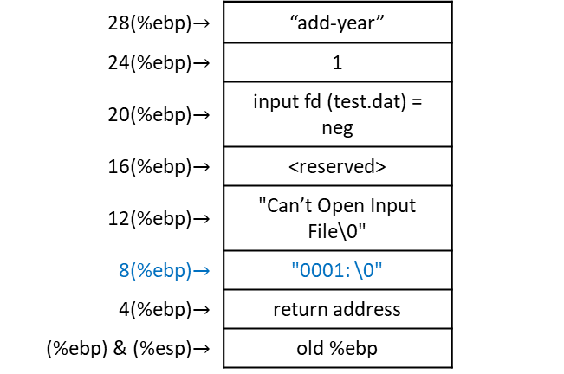
Robust add-year-robust.s: open I/O files $→$if input file does not exist $→$error-exit.s
.include "linux.s"
.equ ST_ERROR_CODE, 8
.equ ST_ERROR_MSG, 12
.globl error_exit
.type error_exit, @function
error_exit:
pushl %ebp
movl %esp, %ebp
# Write out error code
movl ST_ERROR_CODE(%ebp), %ecx
pushl %ecx
call count_chars
popl %ecx
movl %eax, %edx
movl $STDERR, %ebx
movl $SYS_WRITE, %eax
int $LINUX_SYSCALL
# Write out error message
movl ST_ERROR_MSG(%ebp), %ecx
pushl %ecx
call count_chars
popl %ecx
movl %eax, %edx
movl $STDERR, %ebx
movl $SYS_WRITE, %eax
int $LINUX_SYSCALL
pushl $STDERR
call write_newline
# Exit with status 1
movl $SYS_EXIT, %eax
movl $1, %ebx
int $LINUX_SYSCALL
28(%ebp)$→$ | “add-year”
24(%ebp)$→$ | 1
20(%ebp)$→$ | input fd (test.dat) = neg
16(%ebp)$→$ | <reserved>
12(%ebp)$→$ | "Can’t Open Input File\0"
8(%ebp)$→$ | "0001: \0"
4(%ebp)$→$ | return address
(%ebp) & (%esp)$→$ | old %ebp
test.dat
(input fd)
EAX = input fd (test.dat) = neg
EBX = “test.datØ”
ECX = “0001: \0"
EDX = 0666
FrederickØ00000000000000000000000000000000BartlettØ000000000000000000000000000000004242 S Prairi
e\nTulsa, OK 55555Ø0000000000000
000000000000000000000000000000000000000000000000000000000000000000000000000000000000…

Slide 25

Robust add-year-robust.s: open I/O files $→$if input file does not exist $→$error-exit.s
.include "linux.s"
.equ ST_ERROR_CODE, 8
.equ ST_ERROR_MSG, 12
.globl error_exit
.type error_exit, @function
error_exit:
pushl %ebp
movl %esp, %ebp
# Write out error code
movl ST_ERROR_CODE(%ebp), %ecx
pushl %ecx
call count_chars
popl %ecx
movl %eax, %edx
movl $STDERR, %ebx
movl $SYS_WRITE, %eax
int $LINUX_SYSCALL
# Write out error message
movl ST_ERROR_MSG(%ebp), %ecx
pushl %ecx
call count_chars
popl %ecx
movl %eax, %edx
movl $STDERR, %ebx
movl $SYS_WRITE, %eax
int $LINUX_SYSCALL
pushl $STDERR
call write_newline
# Exit with status 1
movl $SYS_EXIT, %eax
movl $1, %ebx
int $LINUX_SYSCALL
28(%ebp)$→$ | “add-year”
24(%ebp)$→$ | 1
20(%ebp)$→$ | input fd (test.dat) = neg
16(%ebp)$→$ | <reserved>
12(%ebp)$→$ | "Can’t Open Input File\0"
8(%ebp)$→$ | "0001: \0"
4(%ebp)$→$ | return address
(%ebp)$→$ | old %ebp
-4(%ebp) & (%esp)$→$ | "0001: \0"
test.dat
(input fd)
EAX = input fd (test.dat) = neg
EBX = “test.datØ”
ECX = “0001: \0"
EDX = 0666
FrederickØ00000000000000000000000000000000BartlettØ000000000000000000000000000000004242 S Prairi
e\nTulsa, OK 55555Ø0000000000000
000000000000000000000000000000000000000000000000000000000000000000000000000000000000…

Slide 26
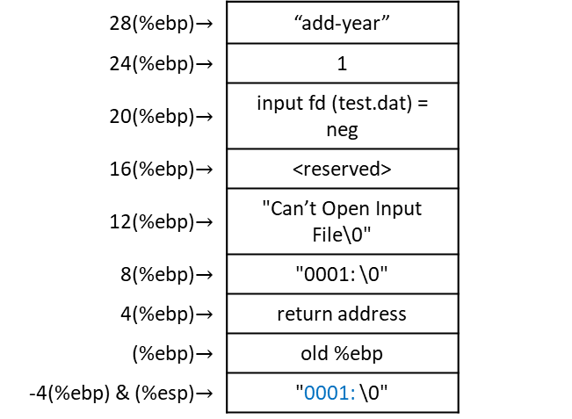
Robust add-year-robust.s: open I/O files $→$if input file does not exist $→$error-exit.s
.include "linux.s"
.equ ST_ERROR_CODE, 8
.equ ST_ERROR_MSG, 12
.globl error_exit
.type error_exit, @function
error_exit:
pushl %ebp
movl %esp, %ebp
# Write out error code
movl ST_ERROR_CODE(%ebp), %ecx
pushl %ecx
call count_chars
popl %ecx
movl %eax, %edx
movl $STDERR, %ebx
movl $SYS_WRITE, %eax
int $LINUX_SYSCALL
# Write out error message
movl ST_ERROR_MSG(%ebp), %ecx
pushl %ecx
call count_chars
popl %ecx
movl %eax, %edx
movl $STDERR, %ebx
movl $SYS_WRITE, %eax
int $LINUX_SYSCALL
pushl $STDERR
call write_newline
# Exit with status 1
movl $SYS_EXIT, %eax
movl $1, %ebx
int $LINUX_SYSCALL
28(%ebp)$→$ | “add-year”
24(%ebp)$→$ | 1
20(%ebp)$→$ | input fd (test.dat) = neg
16(%ebp)$→$ | <reserved>
12(%ebp)$→$ | "Can’t Open Input File\0"
8(%ebp)$→$ | "0001: \0"
4(%ebp)$→$ | return address
(%ebp)$→$ | old %ebp
-4(%ebp) & (%esp)$→$ | "0001: \0"
test.dat
(input fd)
EAX = 6
EBX = “test.datØ”
ECX = “0001: \0"
EDX = 0666
FrederickØ00000000000000000000000000000000BartlettØ000000000000000000000000000000004242 S Prairi
e\nTulsa, OK 55555Ø0000000000000
000000000000000000000000000000000000000000000000000000000000000000000000000000000000…

Slide 27
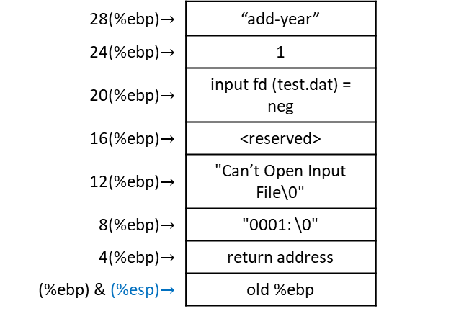
Robust add-year-robust.s: open I/O files $→$if input file does not exist $→$error-exit.s
.include "linux.s"
.equ ST_ERROR_CODE, 8
.equ ST_ERROR_MSG, 12
.globl error_exit
.type error_exit, @function
error_exit:
pushl %ebp
movl %esp, %ebp
# Write out error code
movl ST_ERROR_CODE(%ebp), %ecx
pushl %ecx
call count_chars
popl %ecx
movl %eax, %edx
movl $STDERR, %ebx
movl $SYS_WRITE, %eax
int $LINUX_SYSCALL
# Write out error message
movl ST_ERROR_MSG(%ebp), %ecx
pushl %ecx
call count_chars
popl %ecx
movl %eax, %edx
movl $STDERR, %ebx
movl $SYS_WRITE, %eax
int $LINUX_SYSCALL
pushl $STDERR
call write_newline
# Exit with status 1
movl $SYS_EXIT, %eax
movl $1, %ebx
int $LINUX_SYSCALL
28(%ebp)$→$ | “add-year”
24(%ebp)$→$ | 1
20(%ebp)$→$ | input fd (test.dat) = neg
16(%ebp)$→$ | <reserved>
12(%ebp)$→$ | "Can’t Open Input File\0"
8(%ebp)$→$ | "0001: \0"
4(%ebp)$→$ | return address
(%ebp) & (%esp)$→$ | old %ebp
test.dat
(input fd)
EAX = 6
EBX = “test.datØ”
ECX = “0001: \0"
EDX = 0666
FrederickØ00000000000000000000000000000000BartlettØ000000000000000000000000000000004242 S Prairi
e\nTulsa, OK 55555Ø0000000000000
000000000000000000000000000000000000000000000000000000000000000000000000000000000000…

Slide 28
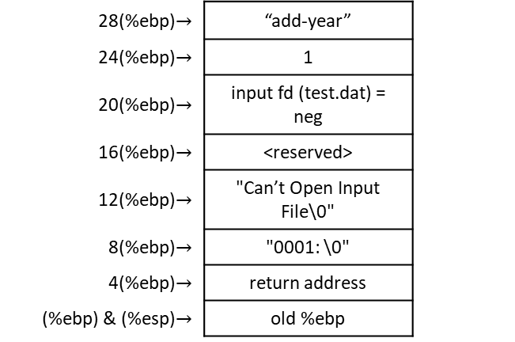
Robust add-year-robust.s: open I/O files $→$if input file does not exist $→$error-exit.s
.include "linux.s"
.equ ST_ERROR_CODE, 8
.equ ST_ERROR_MSG, 12
.globl error_exit
.type error_exit, @function
error_exit:
pushl %ebp
movl %esp, %ebp
# Write out error code
movl ST_ERROR_CODE(%ebp), %ecx
pushl %ecx
call count_chars
popl %ecx
movl %eax, %edx
movl $STDERR, %ebx
movl $SYS_WRITE, %eax
int $LINUX_SYSCALL
# Write out error message
movl ST_ERROR_MSG(%ebp), %ecx
pushl %ecx
call count_chars
popl %ecx
movl %eax, %edx
movl $STDERR, %ebx
movl $SYS_WRITE, %eax
int $LINUX_SYSCALL
pushl $STDERR
call write_newline
# Exit with status 1
movl $SYS_EXIT, %eax
movl $1, %ebx
int $LINUX_SYSCALL
28(%ebp)$→$ | “add-year”
24(%ebp)$→$ | 1
20(%ebp)$→$ | input fd (test.dat) = neg
16(%ebp)$→$ | <reserved>
12(%ebp)$→$ | "Can’t Open Input File\0"
8(%ebp)$→$ | "0001: \0"
4(%ebp)$→$ | return address
(%ebp) & (%esp)$→$ | old %ebp
test.dat
(input fd)
EAX = 6
EBX = “test.datØ”
ECX = “0001: \0"
EDX = 6
FrederickØ00000000000000000000000000000000BartlettØ000000000000000000000000000000004242 S Prairi
e\nTulsa, OK 55555Ø0000000000000
000000000000000000000000000000000000000000000000000000000000000000000000000000000000…

Slide 29
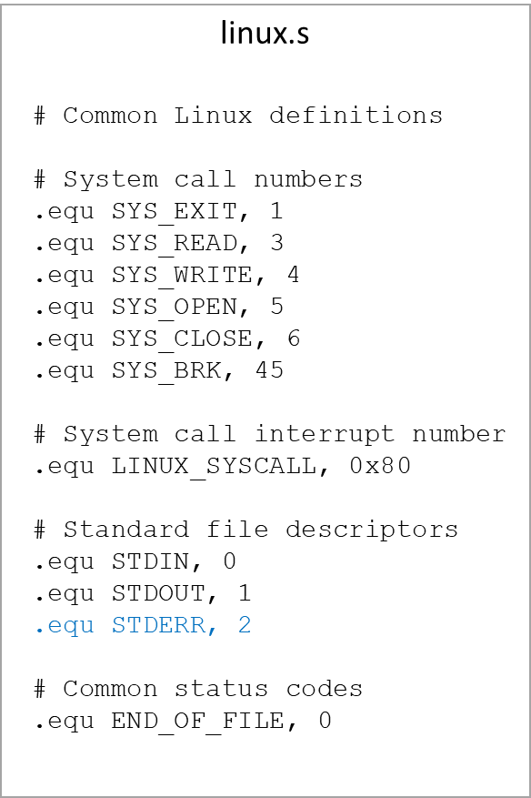
Robust add-year-robust.s: open I/O files $→$if input file does not exist $→$error-exit.s
.include "linux.s"
.equ ST_ERROR_CODE, 8
.equ ST_ERROR_MSG, 12
.globl error_exit
.type error_exit, @function
error_exit:
pushl %ebp
movl %esp, %ebp
# Write out error code
movl ST_ERROR_CODE(%ebp), %ecx
pushl %ecx
call count_chars
popl %ecx
movl %eax, %edx
movl $STDERR, %ebx
movl $SYS_WRITE, %eax
int $LINUX_SYSCALL
# Write out error message
movl ST_ERROR_MSG(%ebp), %ecx
pushl %ecx
call count_chars
popl %ecx
movl %eax, %edx
movl $STDERR, %ebx
movl $SYS_WRITE, %eax
int $LINUX_SYSCALL
pushl $STDERR
call write_newline
# Exit with status 1
movl $SYS_EXIT, %eax
movl $1, %ebx
int $LINUX_SYSCALL
28(%ebp)$→$ | “add-year”
24(%ebp)$→$ | 1
20(%ebp)$→$ | input fd (test.dat) = neg
16(%ebp)$→$ | <reserved>
12(%ebp)$→$ | "Can’t Open Input File\0"
8(%ebp)$→$ | "0001: \0"
4(%ebp)$→$ | return address
(%ebp) & (%esp)$→$ | old %ebp
test.dat
(input fd)
EAX = 6
EBX = 2
ECX = “0001: \0"
EDX = 6
FrederickØ00000000000000000000000000000000BartlettØ000000000000000000000000000000004242 S Prairi
e\nTulsa, OK 55555Ø0000000000000
000000000000000000000000000000000000000000000000000000000000000000000000000000000000…

Slide 30
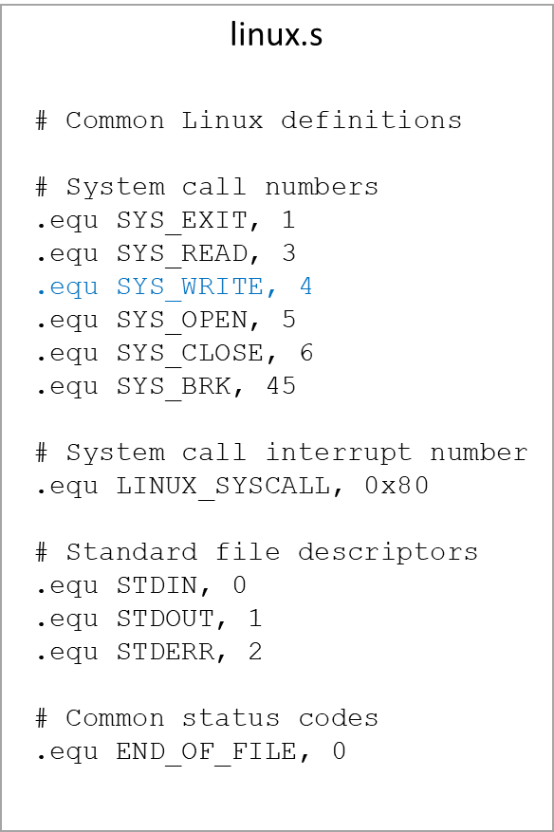
Robust add-year-robust.s: open I/O files $→$if input file does not exist $→$error-exit.s
.include "linux.s"
.equ ST_ERROR_CODE, 8
.equ ST_ERROR_MSG, 12
.globl error_exit
.type error_exit, @function
error_exit:
pushl %ebp
movl %esp, %ebp
# Write out error code
movl ST_ERROR_CODE(%ebp), %ecx
pushl %ecx
call count_chars
popl %ecx
movl %eax, %edx
movl $STDERR, %ebx
movl $SYS_WRITE, %eax
int $LINUX_SYSCALL
# Write out error message
movl ST_ERROR_MSG(%ebp), %ecx
pushl %ecx
call count_chars
popl %ecx
movl %eax, %edx
movl $STDERR, %ebx
movl $SYS_WRITE, %eax
int $LINUX_SYSCALL
pushl $STDERR
call write_newline
# Exit with status 1
movl $SYS_EXIT, %eax
movl $1, %ebx
int $LINUX_SYSCALL
28(%ebp)$→$ | “add-year”
24(%ebp)$→$ | 1
20(%ebp)$→$ | input fd (test.dat) = neg
16(%ebp)$→$ | <reserved>
12(%ebp)$→$ | "Can’t Open Input File\0"
8(%ebp)$→$ | "0001: \0"
4(%ebp)$→$ | return address
(%ebp) & (%esp)$→$ | old %ebp
test.dat
(input fd)
EAX = 4
EBX = 2
ECX = “0001: \0"
EDX = 6
FrederickØ00000000000000000000000000000000BartlettØ000000000000000000000000000000004242 S Prairi
e\nTulsa, OK 55555Ø0000000000000
000000000000000000000000000000000000000000000000000000000000000000000000000000000000…

Slide 31
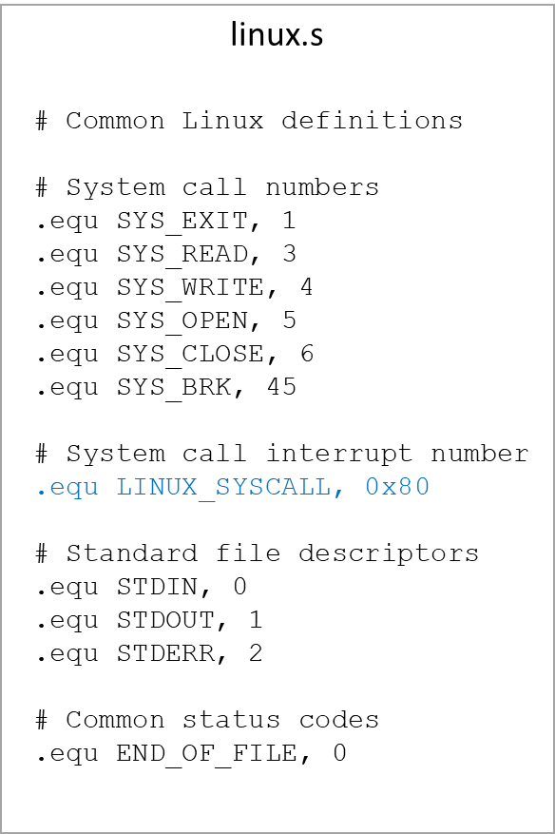
Robust add-year-robust.s: open I/O files $→$if input file does not exist $→$error-exit.s
.include "linux.s"
.equ ST_ERROR_CODE, 8
.equ ST_ERROR_MSG, 12
.globl error_exit
.type error_exit, @function
error_exit:
pushl %ebp
movl %esp, %ebp
# Write out error code
movl ST_ERROR_CODE(%ebp), %ecx
pushl %ecx
call count_chars
popl %ecx
movl %eax, %edx
movl $STDERR, %ebx
movl $SYS_WRITE, %eax
int $LINUX_SYSCALL
# Write out error message
movl ST_ERROR_MSG(%ebp), %ecx
pushl %ecx
call count_chars
popl %ecx
movl %eax, %edx
movl $STDERR, %ebx
movl $SYS_WRITE, %eax
int $LINUX_SYSCALL
pushl $STDERR
call write_newline
# Exit with status 1
movl $SYS_EXIT, %eax
movl $1, %ebx
int $LINUX_SYSCALL
28(%ebp)$→$ | “add-year”
24(%ebp)$→$ | 1
20(%ebp)$→$ | input fd (test.dat) = neg
16(%ebp)$→$ | <reserved>
12(%ebp)$→$ | "Can’t Open Input File\0"
8(%ebp)$→$ | "0001: \0"
4(%ebp)$→$ | return address
(%ebp) & (%esp)$→$ | old %ebp
Terminal
0001:
test.dat
(input fd)
EAX = 4 write
EBX = 2 screen
ECX = “0001: \0“ buffer
EDX = 6 size
FrederickØ00000000000000000000000000000000BartlettØ000000000000000000000000000000004242 S Prairi
e\nTulsa, OK 55555Ø0000000000000
000000000000000000000000000000000000000000000000000000000000000000000000000000000000…

Slide 32
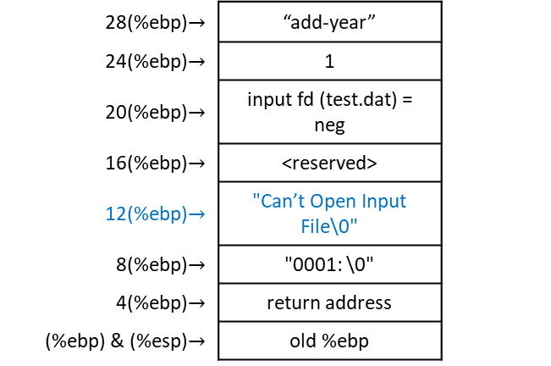
Robust add-year-robust.s: open I/O files $→$if input file does not exist $→$error-exit.s
.include "linux.s"
.equ ST_ERROR_CODE, 8
.equ ST_ERROR_MSG, 12
.globl error_exit
.type error_exit, @function
error_exit:
pushl %ebp
movl %esp, %ebp
# Write out error code
movl ST_ERROR_CODE(%ebp), %ecx
pushl %ecx
call count_chars
popl %ecx
movl %eax, %edx
movl $STDERR, %ebx
movl $SYS_WRITE, %eax
int $LINUX_SYSCALL
# Write out error message
movl ST_ERROR_MSG(%ebp), %ecx
pushl %ecx
call count_chars
popl %ecx
movl %eax, %edx
movl $STDERR, %ebx
movl $SYS_WRITE, %eax
int $LINUX_SYSCALL
pushl $STDERR
call write_newline
# Exit with status 1
movl $SYS_EXIT, %eax
movl $1, %ebx
int $LINUX_SYSCALL
28(%ebp)$→$ | “add-year”
24(%ebp)$→$ | 1
20(%ebp)$→$ | input fd (test.dat) = neg
16(%ebp)$→$ | <reserved>
12(%ebp)$→$ | "Can’t Open Input File\0"
8(%ebp)$→$ | "0001: \0"
4(%ebp)$→$ | return address
(%ebp) & (%esp)$→$ | old %ebp
Terminal
0001:
test.dat
(input fd)
EAX = 4
EBX = 2
ECX = "Can’t Open Input File\0"
EDX = 6
FrederickØ00000000000000000000000000000000BartlettØ000000000000000000000000000000004242 S Prairi
e\nTulsa, OK 55555Ø0000000000000
000000000000000000000000000000000000000000000000000000000000000000000000000000000000…

Slide 33
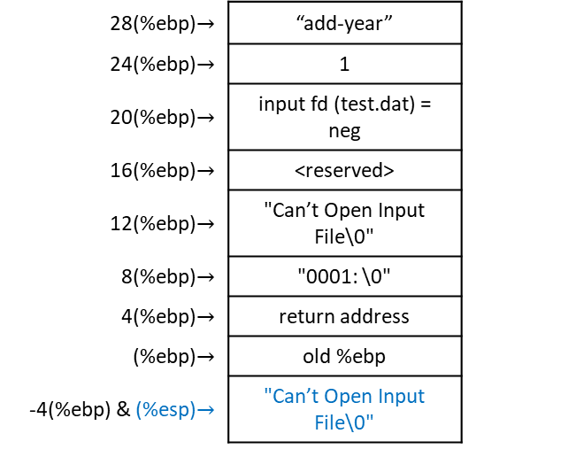
Robust add-year-robust.s: open I/O files $→$if input file does not exist $→$error-exit.s
.include "linux.s"
.equ ST_ERROR_CODE, 8
.equ ST_ERROR_MSG, 12
.globl error_exit
.type error_exit, @function
error_exit:
pushl %ebp
movl %esp, %ebp
# Write out error code
movl ST_ERROR_CODE(%ebp), %ecx
pushl %ecx
call count_chars
popl %ecx
movl %eax, %edx
movl $STDERR, %ebx
movl $SYS_WRITE, %eax
int $LINUX_SYSCALL
# Write out error message
movl ST_ERROR_MSG(%ebp), %ecx
pushl %ecx
call count_chars
popl %ecx
movl %eax, %edx
movl $STDERR, %ebx
movl $SYS_WRITE, %eax
int $LINUX_SYSCALL
pushl $STDERR
call write_newline
# Exit with status 1
movl $SYS_EXIT, %eax
movl $1, %ebx
int $LINUX_SYSCALL
28(%ebp)$→$ | “add-year”
24(%ebp)$→$ | 1
20(%ebp)$→$ | input fd (test.dat) = neg
16(%ebp)$→$ | <reserved>
12(%ebp)$→$ | "Can’t Open Input File\0"
8(%ebp)$→$ | "0001: \0"
4(%ebp)$→$ | return address
(%ebp)$→$ | old %ebp
-4(%ebp) & (%esp)$→$ | "Can’t Open Input File\0"
Terminal
0001:
test.dat
(input fd)
EAX = 4
EBX = 2
ECX = "Can’t Open Input File\0"
EDX = 6
FrederickØ00000000000000000000000000000000BartlettØ000000000000000000000000000000004242 S Prairi
e\nTulsa, OK 55555Ø0000000000000
000000000000000000000000000000000000000000000000000000000000000000000000000000000000…

Slide 34
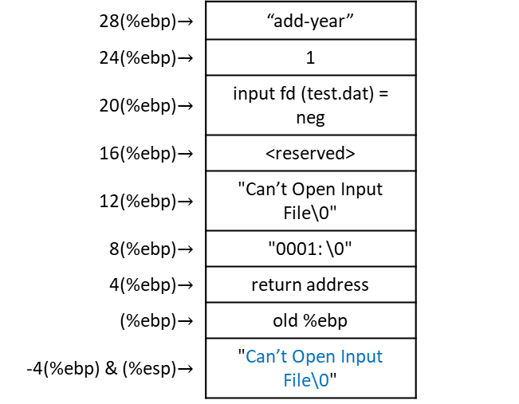
Robust add-year-robust.s: open I/O files $→$if input file does not exist $→$error-exit.s
.include "linux.s"
.equ ST_ERROR_CODE, 8
.equ ST_ERROR_MSG, 12
.globl error_exit
.type error_exit, @function
error_exit:
pushl %ebp
movl %esp, %ebp
# Write out error code
movl ST_ERROR_CODE(%ebp), %ecx
pushl %ecx
call count_chars
popl %ecx
movl %eax, %edx
movl $STDERR, %ebx
movl $SYS_WRITE, %eax
int $LINUX_SYSCALL
# Write out error message
movl ST_ERROR_MSG(%ebp), %ecx
pushl %ecx
call count_chars
popl %ecx
movl %eax, %edx
movl $STDERR, %ebx
movl $SYS_WRITE, %eax
int $LINUX_SYSCALL
pushl $STDERR
call write_newline
# Exit with status 1
movl $SYS_EXIT, %eax
movl $1, %ebx
int $LINUX_SYSCALL
28(%ebp)$→$ | “add-year”
24(%ebp)$→$ | 1
20(%ebp)$→$ | input fd (test.dat) = neg
16(%ebp)$→$ | <reserved>
12(%ebp)$→$ | "Can’t Open Input File\0"
8(%ebp)$→$ | "0001: \0"
4(%ebp)$→$ | return address
(%ebp)$→$ | old %ebp
-4(%ebp) & (%esp)$→$ | "Can’t Open Input File\0"
Terminal
0001:
test.dat
(input fd)
EAX = 21
EBX = 2
ECX = "Can’t Open Input File\0"
EDX = 6
FrederickØ00000000000000000000000000000000BartlettØ000000000000000000000000000000004242 S Prairi
e\nTulsa, OK 55555Ø0000000000000
000000000000000000000000000000000000000000000000000000000000000000000000000000000000…

Slide 35
Robust add-year-robust.s: open I/O files $→$if input file does not exist $→$error-exit.s
.include "linux.s"
.equ ST_ERROR_CODE, 8
.equ ST_ERROR_MSG, 12
.globl error_exit
.type error_exit, @function
error_exit:
pushl %ebp
movl %esp, %ebp
# Write out error code
movl ST_ERROR_CODE(%ebp), %ecx
pushl %ecx
call count_chars
popl %ecx
movl %eax, %edx
movl $STDERR, %ebx
movl $SYS_WRITE, %eax
int $LINUX_SYSCALL
# Write out error message
movl ST_ERROR_MSG(%ebp), %ecx
pushl %ecx
call count_chars
popl %ecx
movl %eax, %edx
movl $STDERR, %ebx
movl $SYS_WRITE, %eax
int $LINUX_SYSCALL
pushl $STDERR
call write_newline
# Exit with status 1
movl $SYS_EXIT, %eax
movl $1, %ebx
int $LINUX_SYSCALL
28(%ebp)$→$ | “add-year”
24(%ebp)$→$ | 1
20(%ebp)$→$ | input fd (test.dat) = neg
16(%ebp)$→$ | <reserved>
12(%ebp)$→$ | "Can’t Open Input File\0"
8(%ebp)$→$ | "0001: \0"
4(%ebp)$→$ | return address
(%ebp) & (%esp)$→$ | old %ebp
Terminal
0001:
test.dat
(input fd)
EAX = 21
EBX = 2
ECX = "Can’t Open Input File\0"
EDX = 6
FrederickØ00000000000000000000000000000000BartlettØ000000000000000000000000000000004242 S Prairi
e\nTulsa, OK 55555Ø0000000000000
000000000000000000000000000000000000000000000000000000000000000000000000000000000000…

Slide 36
Robust add-year-robust.s: open I/O files $→$if input file does not exist $→$error-exit.s
.include "linux.s"
.equ ST_ERROR_CODE, 8
.equ ST_ERROR_MSG, 12
.globl error_exit
.type error_exit, @function
error_exit:
pushl %ebp
movl %esp, %ebp
# Write out error code
movl ST_ERROR_CODE(%ebp), %ecx
pushl %ecx
call count_chars
popl %ecx
movl %eax, %edx
movl $STDERR, %ebx
movl $SYS_WRITE, %eax
int $LINUX_SYSCALL
# Write out error message
movl ST_ERROR_MSG(%ebp), %ecx
pushl %ecx
call count_chars
popl %ecx
movl %eax, %edx
movl $STDERR, %ebx
movl $SYS_WRITE, %eax
int $LINUX_SYSCALL
pushl $STDERR
call write_newline
# Exit with status 1
movl $SYS_EXIT, %eax
movl $1, %ebx
int $LINUX_SYSCALL
28(%ebp)$→$ | “add-year”
24(%ebp)$→$ | 1
20(%ebp)$→$ | input fd (test.dat) = neg
16(%ebp)$→$ | <reserved>
12(%ebp)$→$ | "Can’t Open Input File\0"
8(%ebp)$→$ | "0001: \0"
4(%ebp)$→$ | return address
(%ebp) & (%esp)$→$ | old %ebp
Terminal
0001:
test.dat
(input fd)
EAX = 21
EBX = 2
ECX = "Can’t Open Input File\0"
EDX = 21
FrederickØ00000000000000000000000000000000BartlettØ000000000000000000000000000000004242 S Prairi
e\nTulsa, OK 55555Ø0000000000000
000000000000000000000000000000000000000000000000000000000000000000000000000000000000…

Slide 37
Robust add-year-robust.s: open I/O files $→$if input file does not exist $→$error-exit.s
.include "linux.s"
.equ ST_ERROR_CODE, 8
.equ ST_ERROR_MSG, 12
.globl error_exit
.type error_exit, @function
error_exit:
pushl %ebp
movl %esp, %ebp
# Write out error code
movl ST_ERROR_CODE(%ebp), %ecx
pushl %ecx
call count_chars
popl %ecx
movl %eax, %edx
movl $STDERR, %ebx
movl $SYS_WRITE, %eax
int $LINUX_SYSCALL
# Write out error message
movl ST_ERROR_MSG(%ebp), %ecx
pushl %ecx
call count_chars
popl %ecx
movl %eax, %edx
movl $STDERR, %ebx
movl $SYS_WRITE, %eax
int $LINUX_SYSCALL
pushl $STDERR
call write_newline
# Exit with status 1
movl $SYS_EXIT, %eax
movl $1, %ebx
int $LINUX_SYSCALL
28(%ebp)$→$ | “add-year”
24(%ebp)$→$ | 1
20(%ebp)$→$ | input fd (test.dat) = neg
16(%ebp)$→$ | <reserved>
12(%ebp)$→$ | "Can’t Open Input File\0"
8(%ebp)$→$ | "0001: \0"
4(%ebp)$→$ | return address
(%ebp) & (%esp)$→$ | old %ebp
Terminal
0001:
test.dat
(input fd)
EAX = 21
EBX = 2
ECX = "Can’t Open Input File\0"
EDX = 21
FrederickØ00000000000000000000000000000000BartlettØ000000000000000000000000000000004242 S Prairi
e\nTulsa, OK 55555Ø0000000000000
000000000000000000000000000000000000000000000000000000000000000000000000000000000000…

Slide 38
Robust add-year-robust.s: open I/O files $→$if input file does not exist $→$error-exit.s
.include "linux.s"
.equ ST_ERROR_CODE, 8
.equ ST_ERROR_MSG, 12
.globl error_exit
.type error_exit, @function
error_exit:
pushl %ebp
movl %esp, %ebp
# Write out error code
movl ST_ERROR_CODE(%ebp), %ecx
pushl %ecx
call count_chars
popl %ecx
movl %eax, %edx
movl $STDERR, %ebx
movl $SYS_WRITE, %eax
int $LINUX_SYSCALL
# Write out error message
movl ST_ERROR_MSG(%ebp), %ecx
pushl %ecx
call count_chars
popl %ecx
movl %eax, %edx
movl $STDERR, %ebx
movl $SYS_WRITE, %eax
int $LINUX_SYSCALL
pushl $STDERR
call write_newline
# Exit with status 1
movl $SYS_EXIT, %eax
movl $1, %ebx
int $LINUX_SYSCALL
28(%ebp)$→$ | “add-year”
24(%ebp)$→$ | 1
20(%ebp)$→$ | input fd (test.dat) = neg
16(%ebp)$→$ | <reserved>
12(%ebp)$→$ | "Can’t Open Input File\0"
8(%ebp)$→$ | "0001: \0"
4(%ebp)$→$ | return address
(%ebp) & (%esp)$→$ | old %ebp
Terminal
0001:
test.dat
(input fd)
EAX = 21
EBX = 2
ECX = "Can’t Open Input File\0"
EDX = 21
FrederickØ00000000000000000000000000000000BartlettØ000000000000000000000000000000004242 S Prairi
e\nTulsa, OK 55555Ø0000000000000
000000000000000000000000000000000000000000000000000000000000000000000000000000000000…

Slide 39
Robust add-year-robust.s: open I/O files $→$if input file does not exist $→$error-exit.s
.include "linux.s"
.equ ST_ERROR_CODE, 8
.equ ST_ERROR_MSG, 12
.globl error_exit
.type error_exit, @function
error_exit:
pushl %ebp
movl %esp, %ebp
# Write out error code
movl ST_ERROR_CODE(%ebp), %ecx
pushl %ecx
call count_chars
popl %ecx
movl %eax, %edx
movl $STDERR, %ebx
movl $SYS_WRITE, %eax
int $LINUX_SYSCALL
# Write out error message
movl ST_ERROR_MSG(%ebp), %ecx
pushl %ecx
call count_chars
popl %ecx
movl %eax, %edx
movl $STDERR, %ebx
movl $SYS_WRITE, %eax
int $LINUX_SYSCALL
pushl $STDERR
call write_newline
# Exit with status 1
movl $SYS_EXIT, %eax
movl $1, %ebx
int $LINUX_SYSCALL
28(%ebp)$→$ | “add-year”
24(%ebp)$→$ | 1
20(%ebp)$→$ | input fd (test.dat) = neg
16(%ebp)$→$ | <reserved>
12(%ebp)$→$ | "Can’t Open Input File\0"
8(%ebp)$→$ | "0001: \0"
4(%ebp)$→$ | return address
(%ebp) & (%esp)$→$ | old %ebp
Terminal
0001: Can’t Open Input File
test.dat
(input fd)
EAX = 21
EBX = 2
ECX = "Can’t Open Input File\0"
EDX = 21
FrederickØ00000000000000000000000000000000BartlettØ000000000000000000000000000000004242 S Prairi
e\nTulsa, OK 55555Ø0000000000000
000000000000000000000000000000000000000000000000000000000000000000000000000000000000…

Slide 40
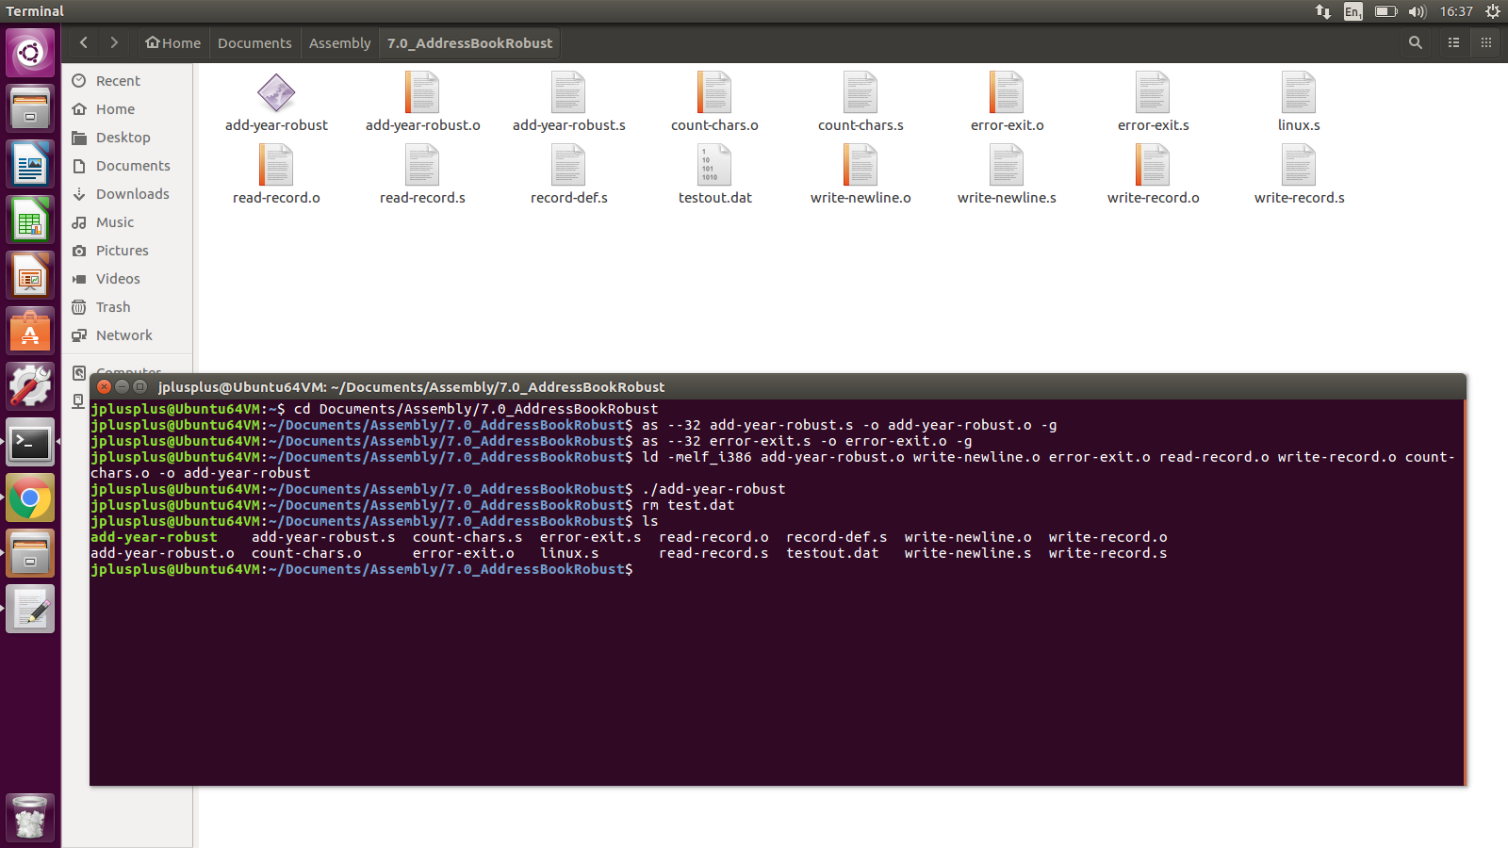
Robust Answer: if input file does not exist

Slide 41
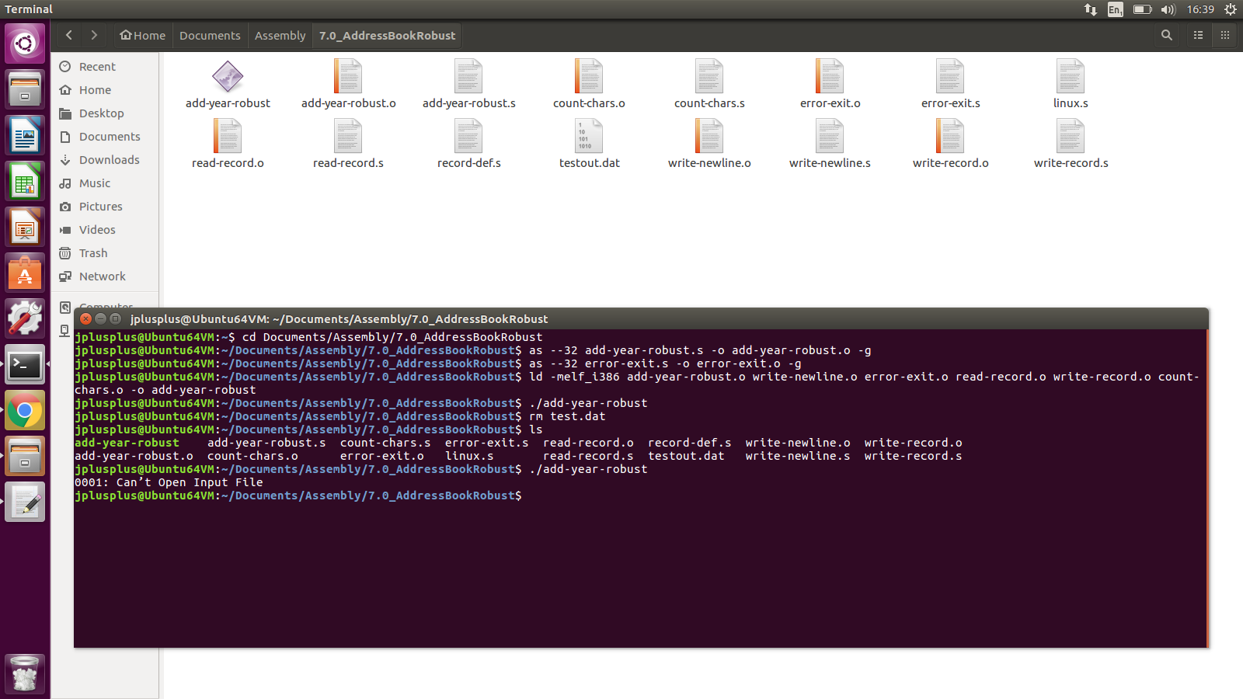
Robust Answer: if input file does not exist
!!!

